Slide 1


Automating File Transfers Securely

Slide 2

Who Am I
Adam Bertram
17 Year IT Veteran
Microsoft MVP (PowerShell)
Blogger: adamtheautomator.com
Technology Writer
Twitter: @adbertram
02

Slide 3

Why Automate File Transfers?
...but it doesn't take that long
Free up time
Big money!
05

Slide 4
Scripts
Let me Help You
No Support
07

Slide 5
Commonly Overlooked Issues with Scripts
LOG
Good Scripts Require A Lot of Planning
Environment
Changes
Error
Handling
Logging
08

Slide 6
MoveIt Central
Two Different Ways to Get There
Time is Money
Software Saves Time
09

Slide 7
The Scenario: Secure B2B File Transfer
What We're Doing
10

Slide 8
4 Steps to Achieving the Goal
1
2
3
4
Monitoring a Folder
Making Changes to the Files
Encrypting Files
Moving Files
11

Slide 9
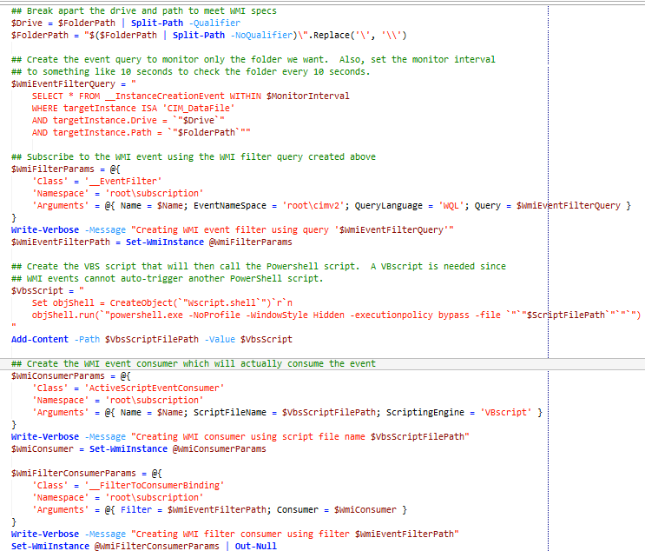
Step #1: Monitoring a Folder
WMI Events
Script Breakdown
Code Length can be Deceiving
12

Slide 10
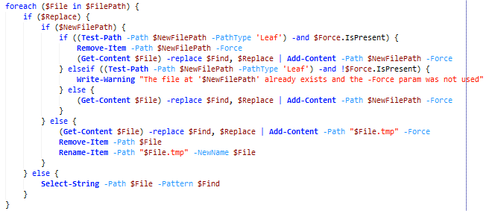
Step #2: Making Changes to Files
Use Get/Add-Content
Script Breakdown
13

Slide 11
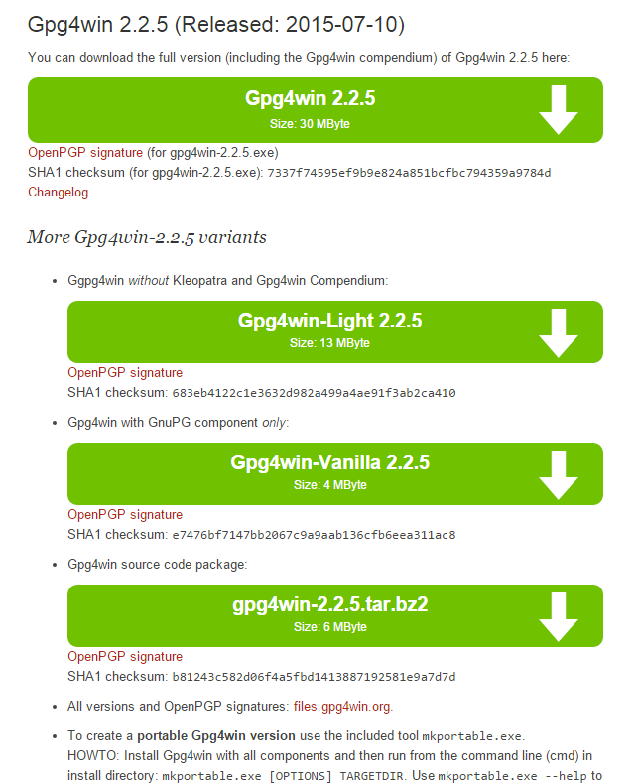
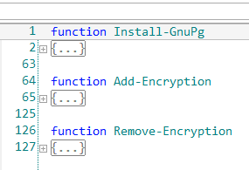
Step #3: Installing GnuPG
14

Slide 12
Step #3: Writing the Script
Big Learning Curve
Cleartext Passwords = Bad
15

Slide 13
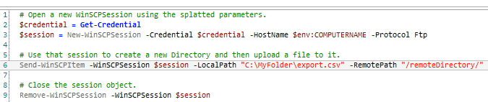
Step #4: Moving files
WinSCP
Sometimes You'll Get Lucky
16

Slide 14
Final Script Thoughts
Some scripts are Hard!
Scripts Can Solve Lots of Problems
17

Slide 15
Comparing Scripts and MoveIT Central
 | Scripts | MoveIT Central
Ease of Use | Red | Green
Reliability | Yellow | Green
Price | Green | Yellow
Flexibility | Green | Green
Time | Red | Green
18

Slide 16


MoveIT Central and PowerShell as a Team
18

Slide 17
Get the Scripts
http://bit.ly/moveitcentralscripts

Slide 18
Questions?
Thank You for Your Attention!

